Slide 1
Lead Scoring Case Study
Sagar Prakash Kulkarni
Sai Kumar Matta
Yellapantula Venkata Gowri Sailatha

Slide 2
Problem Statement
Logistic Regression Model to predict score between 0 to 100 which an be used by company as a potential target to convert
A low score is less likely and high score is more likely to convert
The model should also be able to cater to various requirement changes in future.
The model also needs to be tested on test data set for accuracy, sensitivity, specificity and other terms

Slide 3
Data Sanity
Missing values in various columns is calculated
Imputing Missing values
For few missing value entries for columns like Country, Lead quality, etc mode (most recurring) value is assigned
For missing values in column with numeric data like 'TotalVisits','Page Views Per Visit’, mean value is assigned
Treating Outliers
For few outliers in numeric data columns “TotalVisits”, “Total Time Spent on Website” , 98% percentile value is assigned.
Then boxplot is created for these with respect to Converted (target) variable

Slide 4
Categorical Variables
pd.get_dummies along with drop_first=True is used
Categorical variables are as below
'Country_new’, 'Lead Origin', 'Lead Source', 'Last Activity', 'Specialization’, 'How did you hear about X Education','What is your current occupation’, 'What matters most to you in choosing a course’, 'Tags’, 'Lead Quality’, 'Lead Profile’, 'City’, 'Asymmetrique Activity Index’, 'Asymmetrique Profile Index’, 'Last Notable Activity’

Slide 5
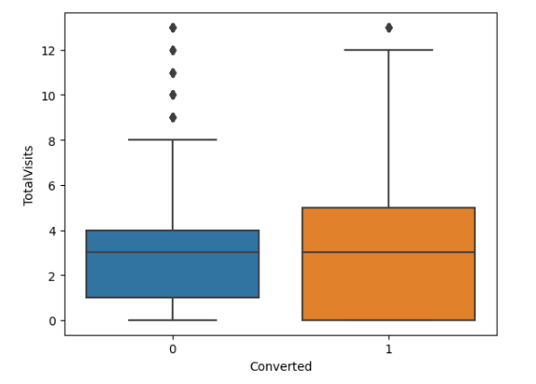
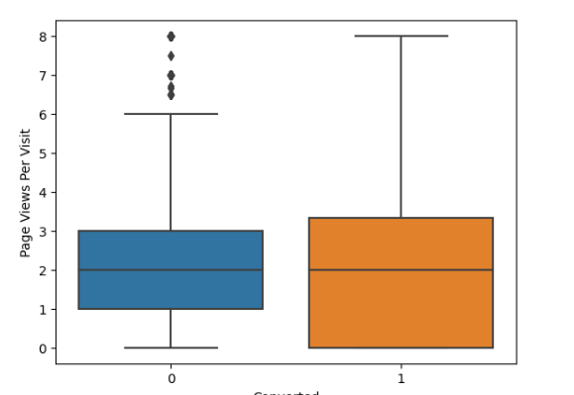
EDA Graphs

Slide 6
Model Building & Feature Selection
Recursive Feature Elimination (RFE) model is used with 25 variables to start with
Based on p value (p value >0.5) and VIF (>5) are eliminated
The final model has all variables which are statistically significant (p value <0.05) and non –correlated variables (VIF less than 5)
Variables with Yes & No are converted to 1 and 0 respectively
Numerical variables are scaled with Standard scaling

Slide 7
Final Model
Lead_Score = [-2.7501 + 0.9997* ('Total Time Spent on Website') + 3.1882 * ('Lead Source_Welingak Website') + (-1.7570) * ('Last Activity_Email Bounced') + (-1.2649) * ('Last Activity_Olark Chat Conversation') + 2.1348 * ('What is your current occupation_Working Professional') + 3.5636 * ('Tags_Busy') + 9.7570*('Tags_Closed by Horizzon') + 10.1190* ('Tags_Lost to EINS') + (-1.1341)*('Tags_Ringing') + (4.6915)*('Tags_Will revert after reading the email') + (-1.4586)*('Tags_switched off') + (-2.0925)*('Lead Quality_Worst') -3.3623*('Lead Profile_Select')+ (-2.7611)*('Lead Profile_Student of SomeSchool') +(2.2725)* ('City_Select')+ (-1.8632)*('Asymmetrique Activity Index_03.Low')+ 3.1677*('Last Notable Activity_Had a Phone Conversation') + (2.6246)*('Last Notable Activity_SMS Sent')]*100

Slide 8
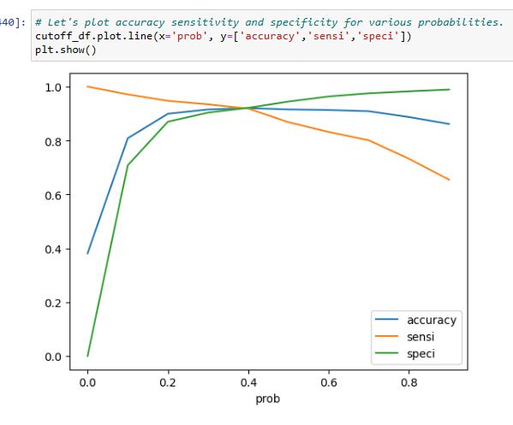
Model Evaluation
First took p value as 0.5 for conversion
Accuracy = 91.5 %, Sensitivity = 86.8%, Specificity = 94.4%, Positive predictive value = 90.6% and Negative predictive value = 92.08%
Then plotted the ROC curve to get the optimum p value. Optimum value was 0.4
Updated parameters with p value as 0.4 Accuracy = 92%, Sensitivity =91.8%, Specificity=92% Positive predicte rate = 87%, Negative predictive value =94.8%
Precision = 90.6%, Recall = 86.28%

Slide 9
Evaluation on test Set
Accuracy = 91.59%
Sensitivity = 92.6%
Specificity = 90.9%

Slide 10
Model Summary & Conclusions
Top 3 variables which should be focussed upon for maximising the probability of conversion
Tags_Lost to EINS
Tags_Closed by Horizzon
Tags_Will revert after reading the email
Top 3 categorical variables which should be focussed upon for lead conversion are as below
Tags
Lead Source
Last Notable Activity
Variables with negative co-efficient can contribute negatively to conversion probability and hence should be avoided
Lead Profile_Select” (co-eff -3.3623),
“Lead Profile_Student of SomeSchool” (co-eff -2.761),
“Lead Quality_Worst” (Co-eff -2.0925)

